Slide 1
Build a Java Full Stack Project with Spring Boot and Angular
COURSE OVERVIEW

Slide 2
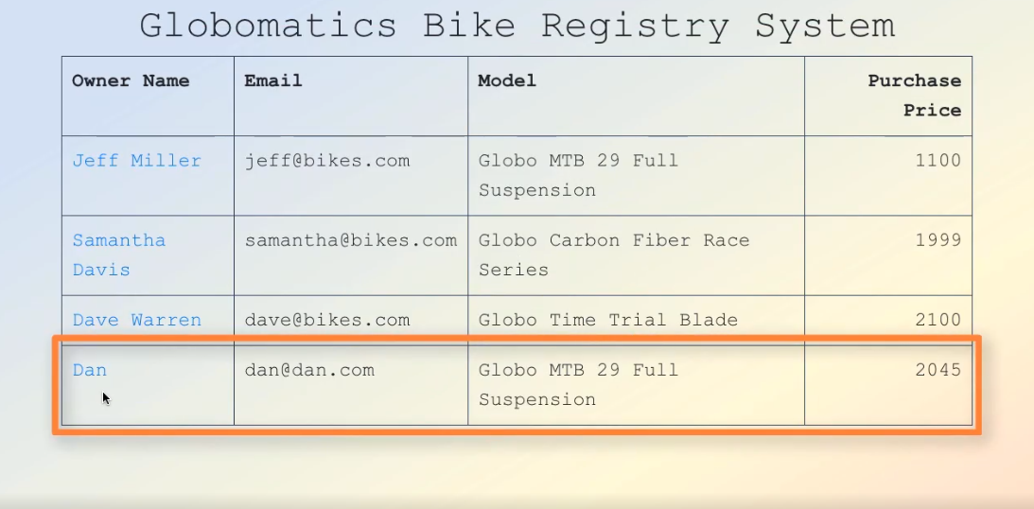

Slide 3
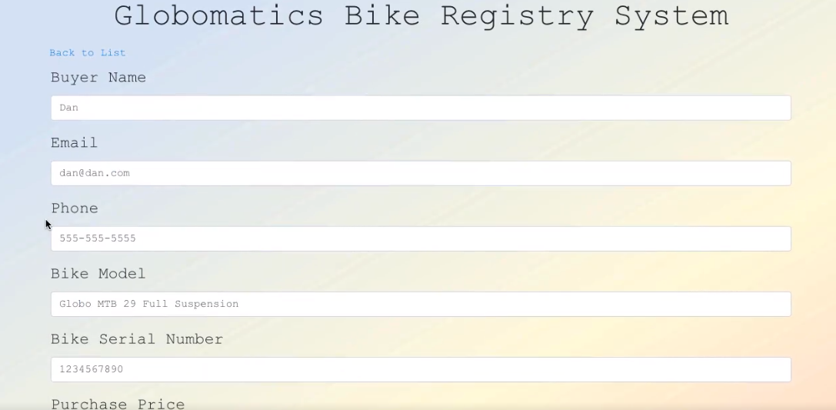

Slide 4
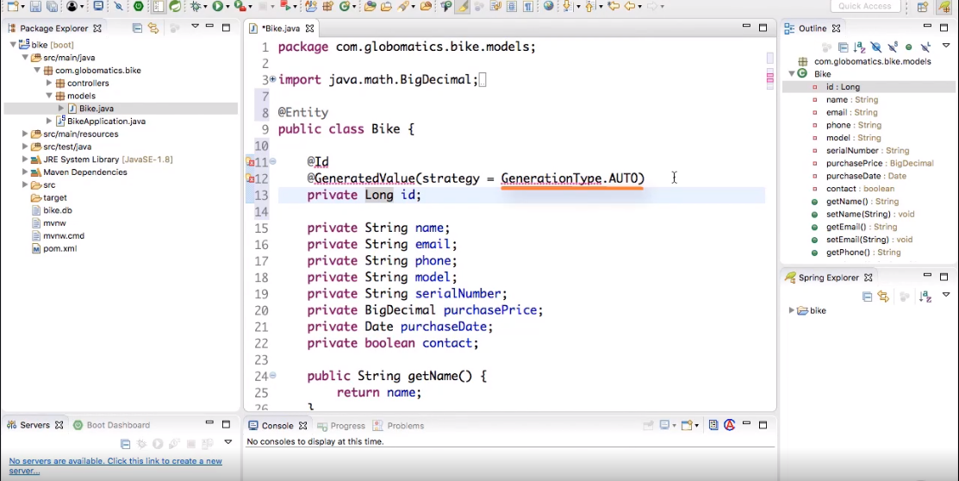

Slide 5
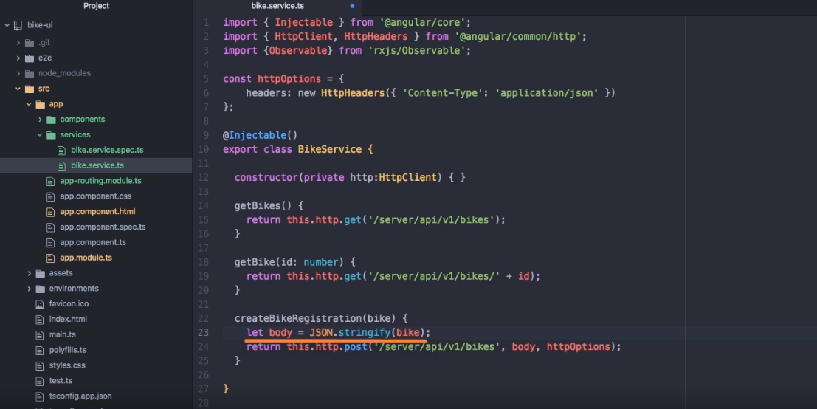

Slide 7
